Slide 1
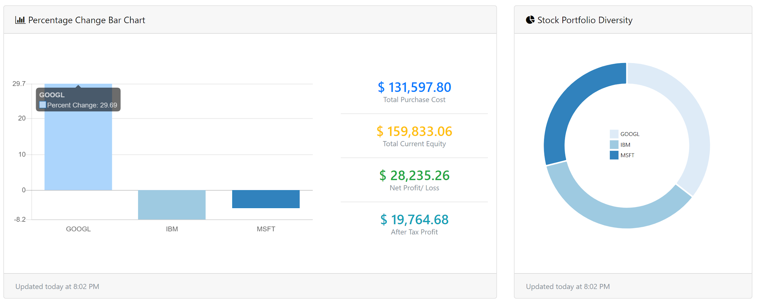
Stockalytics
Derek Brown, Alyssa Drohan, Daniel Gaisberger, Horatio Hodge, Jarrett Horton, Isaiah Johnson, Russell Quao, Isaac Silvious

Slide 2
Objective
We were tasked with creating an user friendly application. Our objective was to create a comprehensive stock application. Our goal as a team was to make an application that uses data visualization tools to help users manage their stocks.

Slide 3
Summary
Stockalytics is a web-app that lets users track, manage, and add stocks to their portfolio in an easy to use manner.

Slide 4
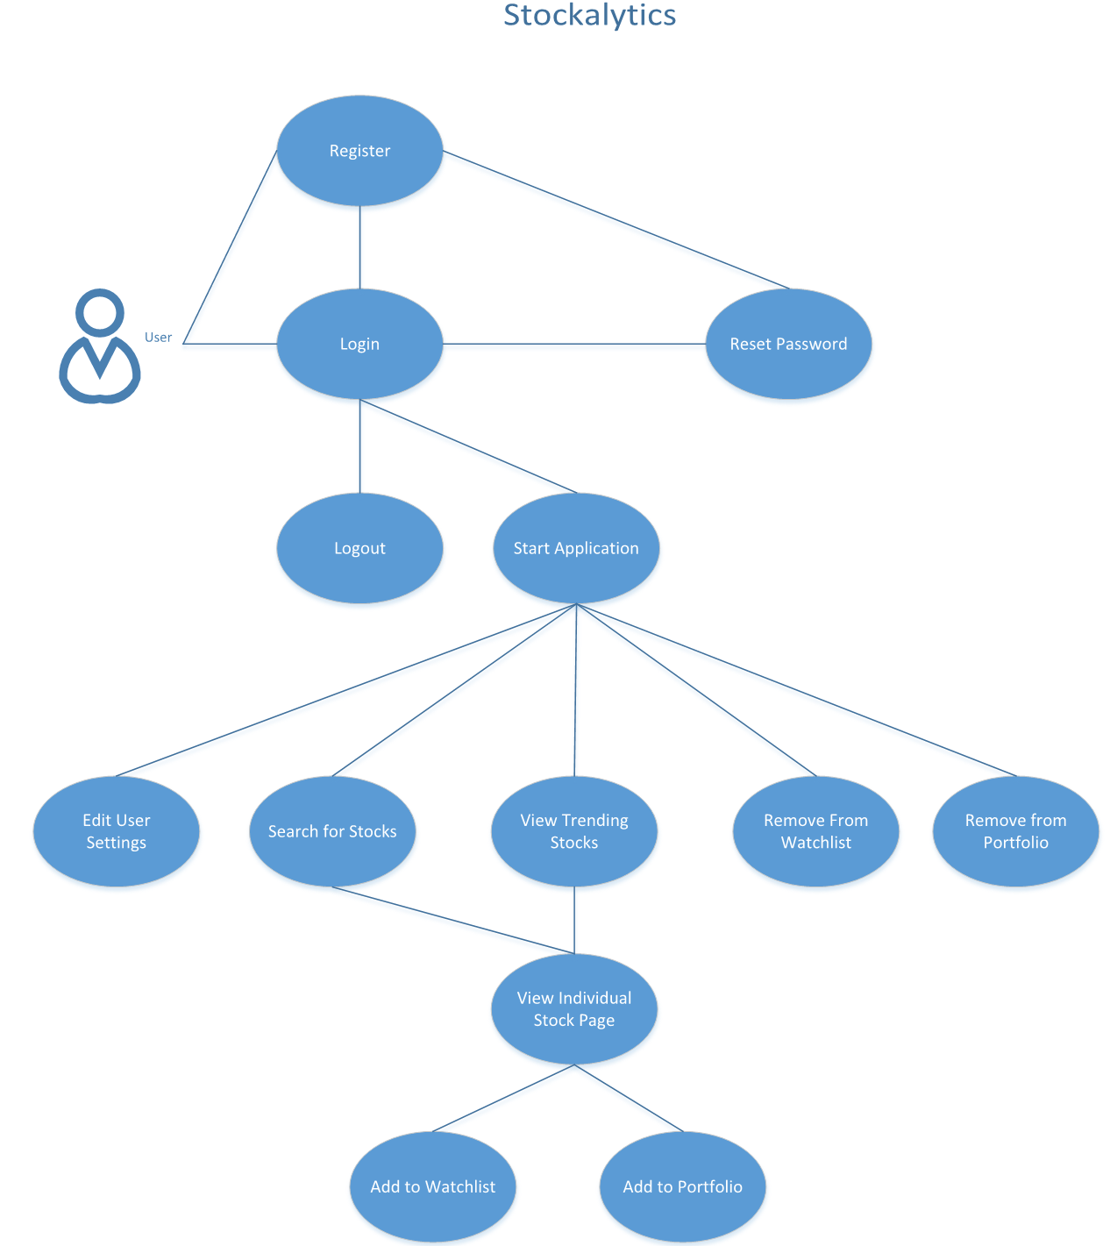
Overview of Use Case

Slide 5
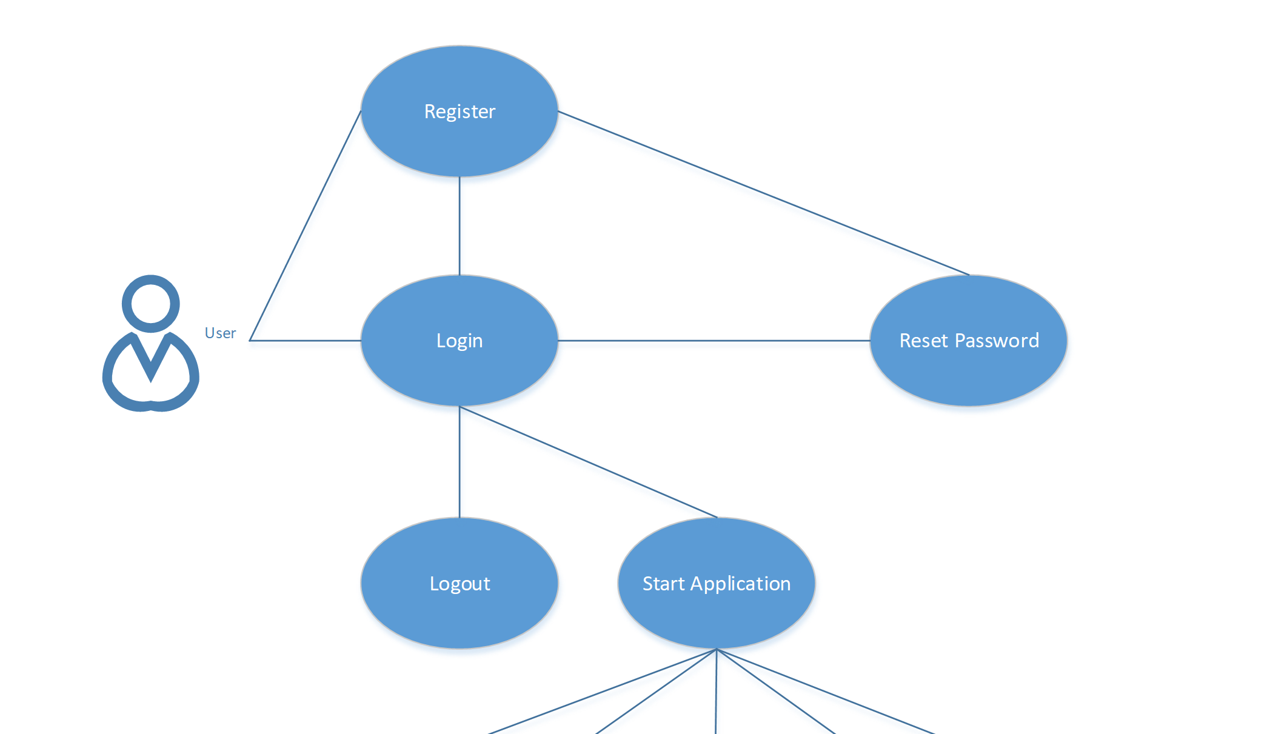
Use Case: Start

Slide 6
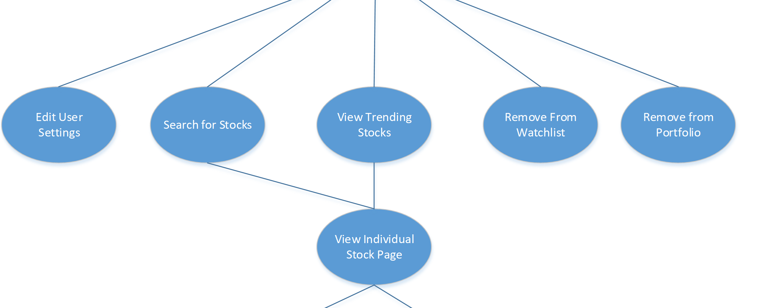
Use Case: Dashboard

Slide 7
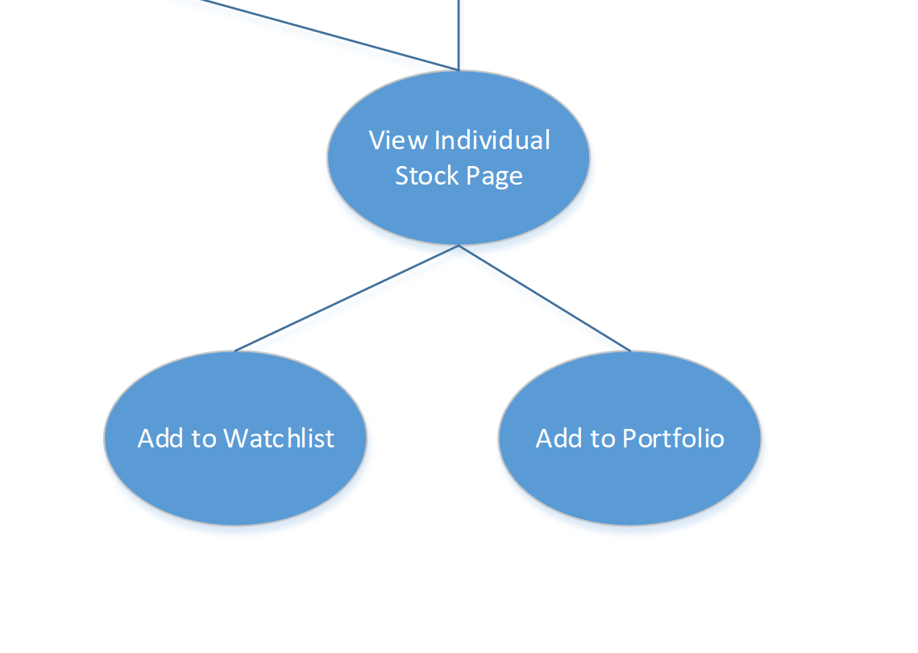
Use Case: Individual Stock Page

Slide 8
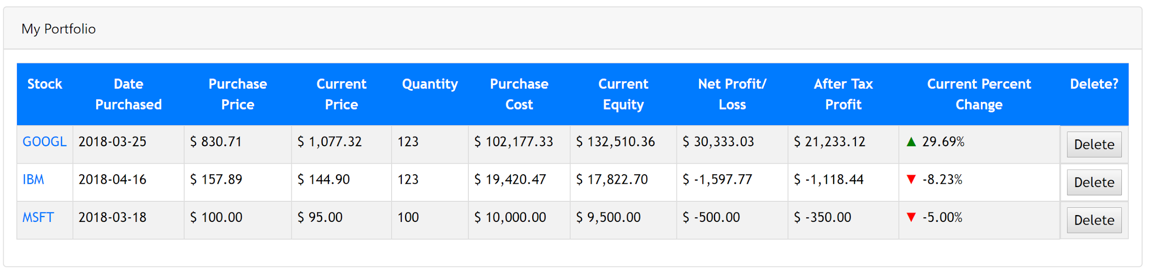
My Portfolio
The portfolio table is a table which lists all the users current stocks in their portfolio. In addition, information such as the date the stock was purchased, the current stock price, quantity, and more are available on the table for the benefit of the user.

Slide 9
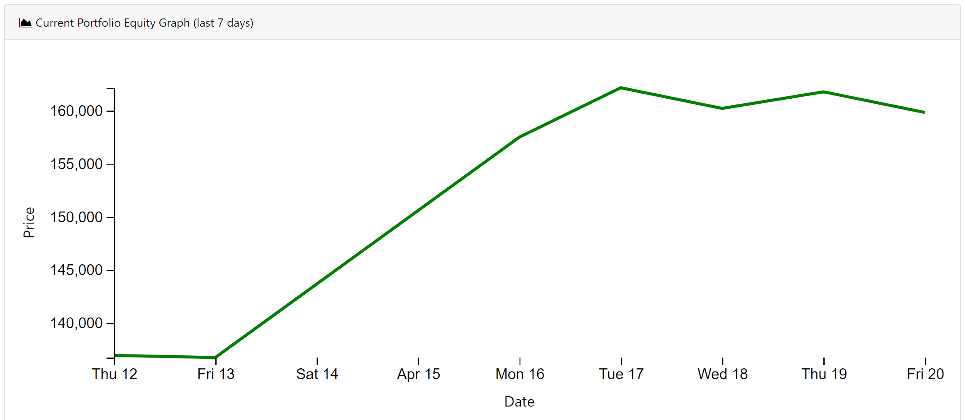
Current Portfolio Equity Graph
This interactive graph shows the current equity for the stocks the user purchases within the last seven days.

Slide 10
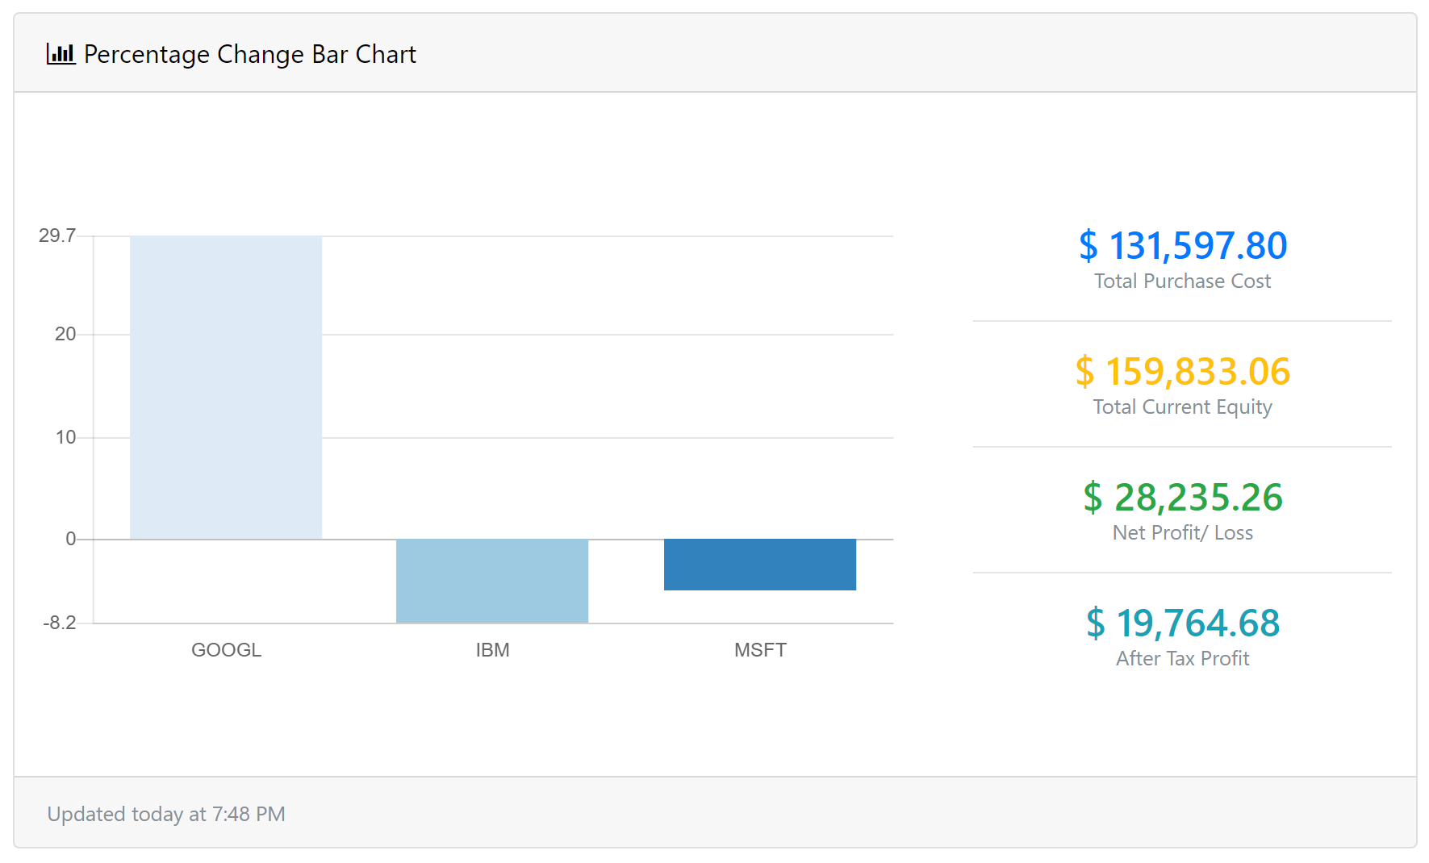
Percentage Change Bar Chart
Like the Portfolio Equity Graph, the Percentage Change Bar Chart shows the total purchased cost, total current equity, net profit/ loss, and after tax in a intuitive bar graph.

Slide 11
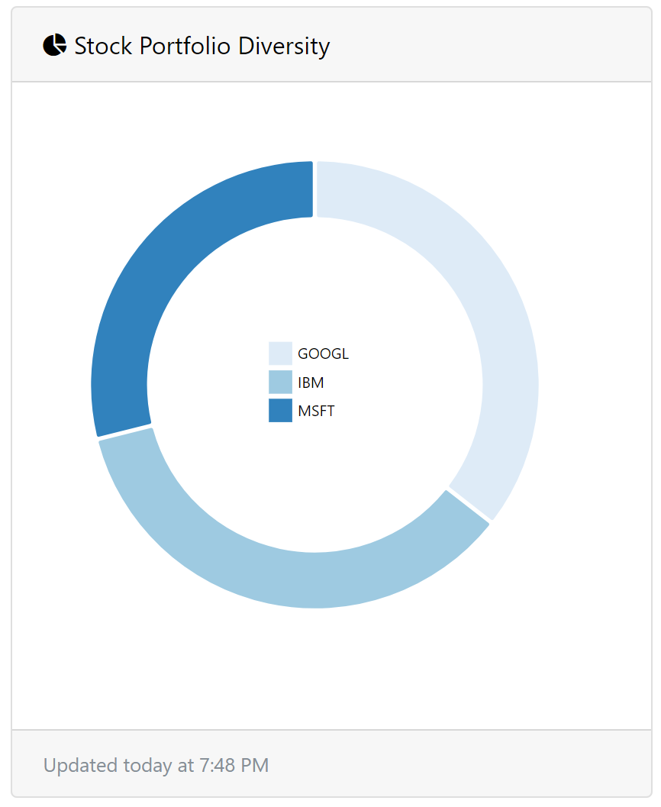
Stock Portfolio Diversity
This section of the dashboard shows the number of different stocks that are in their portfolio. The graph features an on hover function that displays that specific stock and the quantity the user has in relation to the whole portfolio.

Slide 12
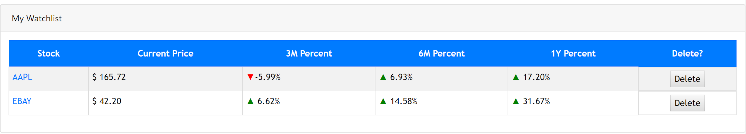
My Watchlist
This table displays all the stocks that are on the users watchlist. The watchlist gives the user a quick overview and reference to stocks that the user potentially wants to purchase.

Slide 13
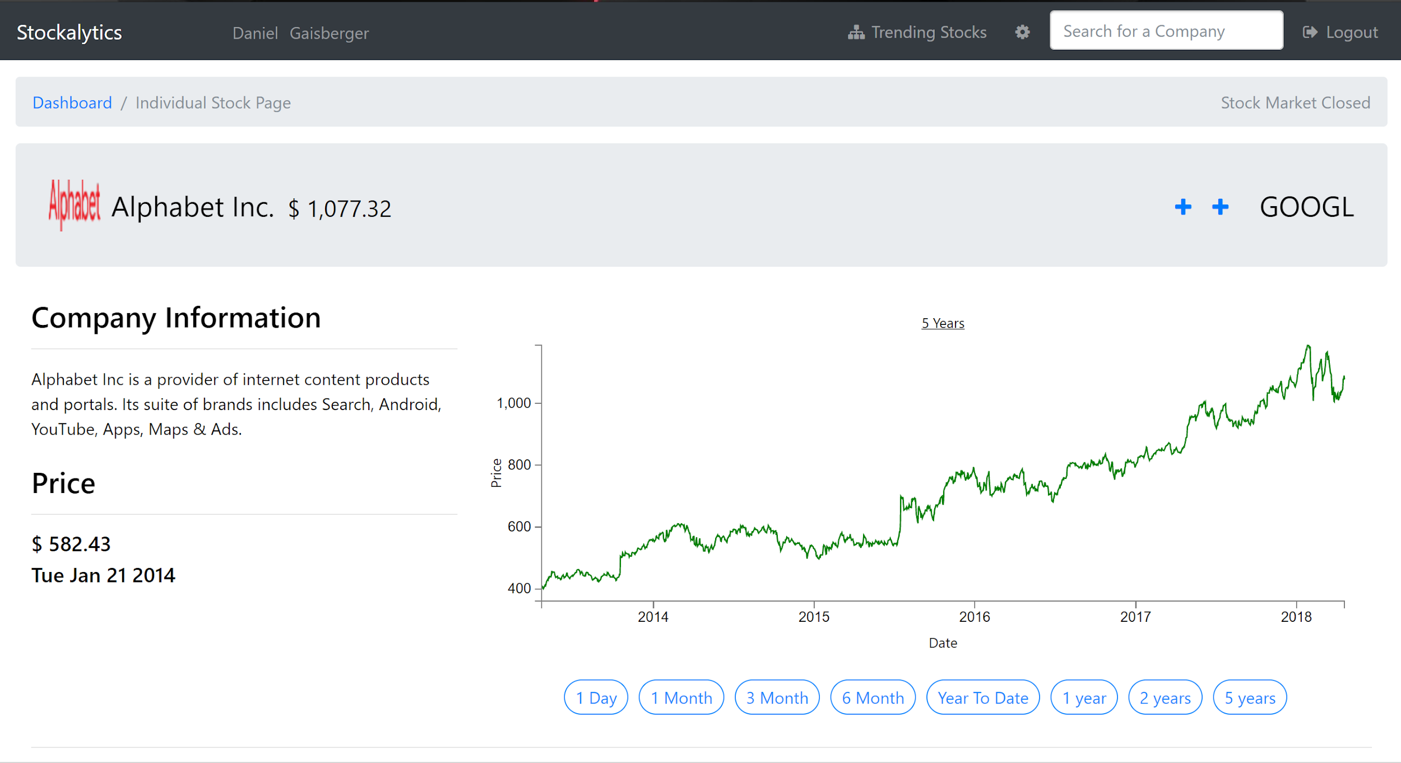
Company information
Our application displays information about the respective company such as their name, a brief summary, current stock price and price history, news articles, and related company prices.

Slide 14
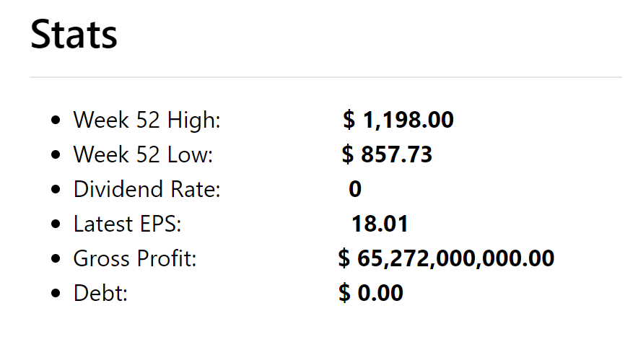
Stats
The Stats section contains information on the companies highs and lows, dividend rates, their latest Earning Per Share, debt, and gross profit.

Slide 15
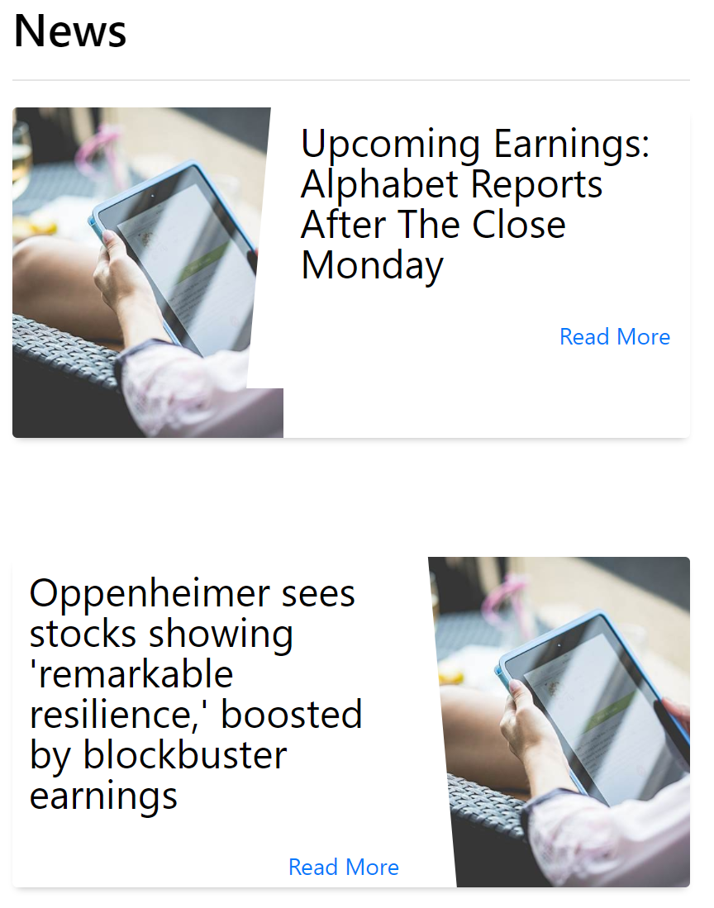
News
This section displays recent news regarding that respective company on New York Stock Exchange.

Slide 16
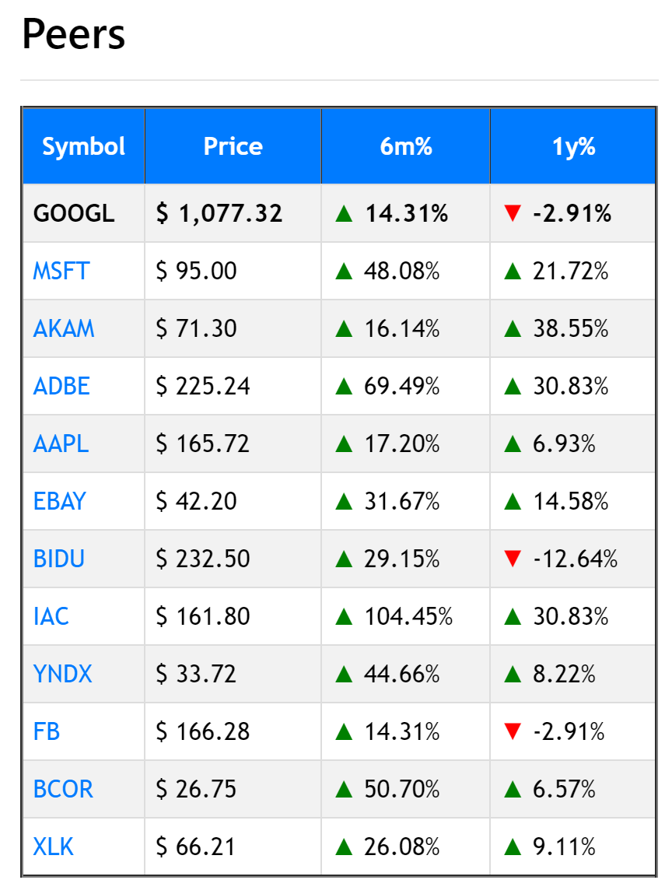
Peers
Peers are group of individuals or entities that share similar characteristics and interests.

Slide 17
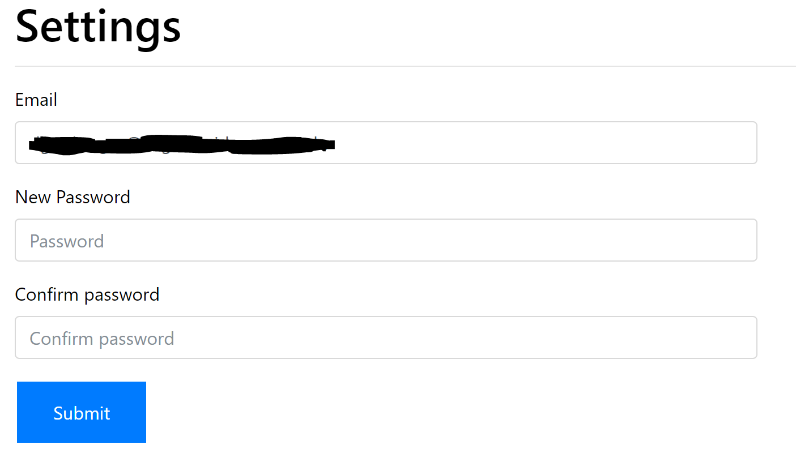
Resetting Account Credentials
In our Settings Page, the user has the option of resetting their login credentials.

Slide 18
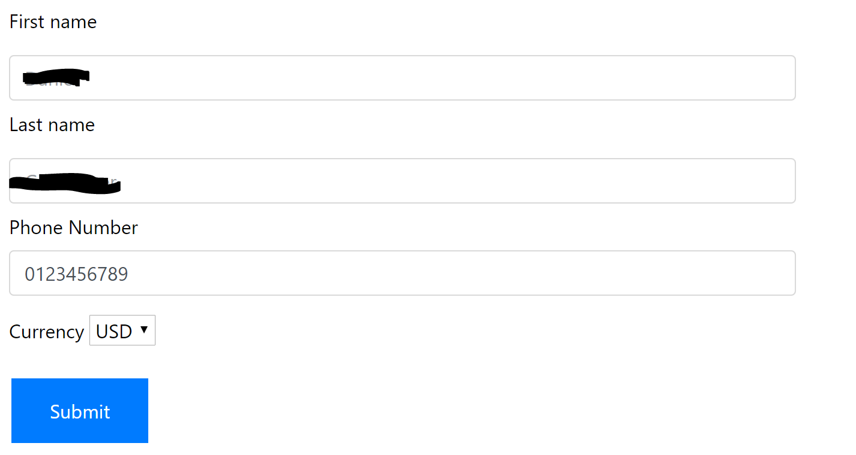
User Info
In addition, the user can also edit their first name, last name and phone number in the boxes provided.

Slide 19
Demo
http://www.stockapp.jarretthorton.com

